Slide 1

NBK SOUTH PODIUM ANALYSIS

Slide 2
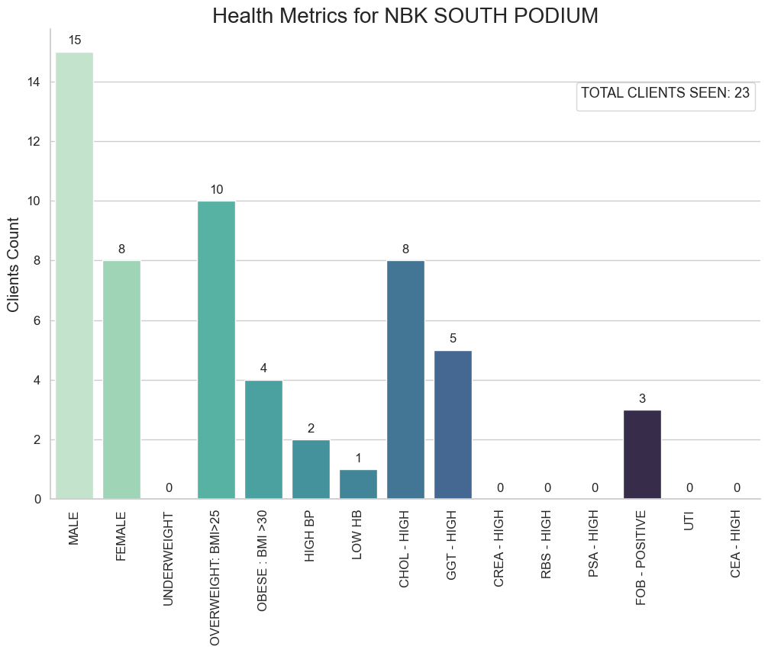
NBK SOUTH PODIUM
The provided chart offers insights into the health profile of individuals associated with the NBK South Podium branch, encompassing a total of 23 individuals. Gender distribution shows a slight skew towards males, with 15 males and 8 females in the sampled population. Analysis of Body Mass Index (BMI) categories reveals a predominance of overweight individuals (10) followed by obese individuals (4), indicating prevalent weight-related concerns. Additionally, health conditions such as high blood pressure (2), low hemoglobin (1), and high cholesterol levels (8) underscore potential cardiovascular and metabolic health risks within the NBK South Podium branch population.
While the sample size is relatively smaller compared to other branch, the observed prevalence of overweight, obesity, and high cholesterol levels suggests significant health risks warranting attention. To address these concerns, targeted health promotion efforts and wellness initiatives are recommended. Implementing strategies focused on promoting healthy lifestyle behaviors, regular health screenings, and access to preventive healthcare services could mitigate identified health risks and enhance overall well-being among NBK South Podium branch
population.

Slide 3
Analysis done by D&W Data Solutions

